Slide 1
Tech Giants Stock Analysis & insights

Slide 2
Tech Giants companies stock
Amazon
Google
Apple
Microsoft

Slide 3
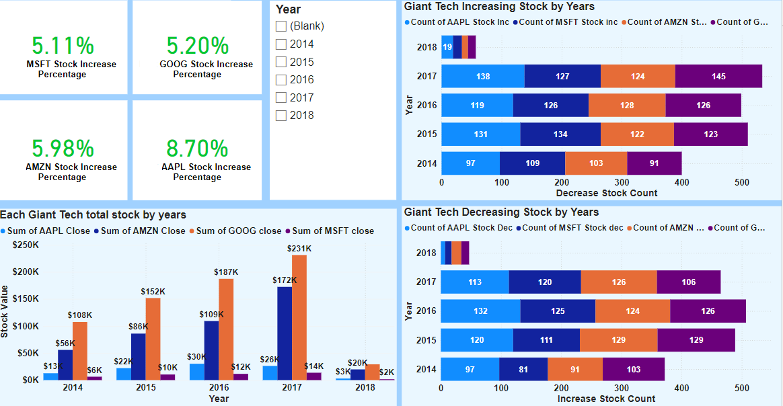
Tech Giants Stock KPI Dashboard

Slide 4
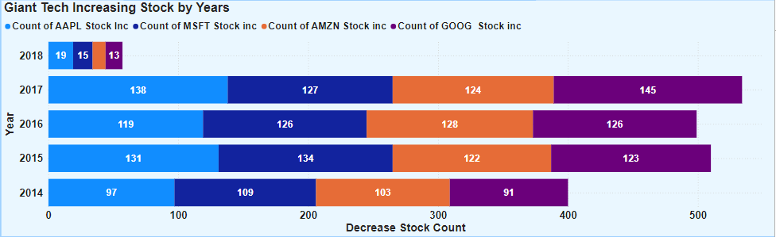
Count of increase Tech Giants Stock
Tech Giant Stock increases:
Apple: In 2014, Apple's stock increased by 97, with further gains of 131 in 2015, 119 in 2016, and 138 in 2017. A small increase of 19 was recorded in 2018. Apple has a total stock increase of 504 over these years.
Average Stock Increase: 100.8.
Microsoft: In 2014, Microsoft's stock increased by 109, followed by 134 in 2015, 126 in 2016, and 127 in 2017. A small increase of 15 was recorded in 2018.
Average Stock Increase: 102.2.
Amazon: In 2014, Amazon's stock increased by 103, with further gains of 122 in 2015, 128 in 2016, and 124 in 2017. An increase of 10 was recorded in 2018.
Average Stock Increase: 97.4.
Google: In 2014, Google’s stock increased by 91, with further gains of 123 in 2015, 126 in 2016, and 145 in 2017. A small increase of 13 was recorded in 2018.
Average Stock Increase: 99.6.

Slide 5
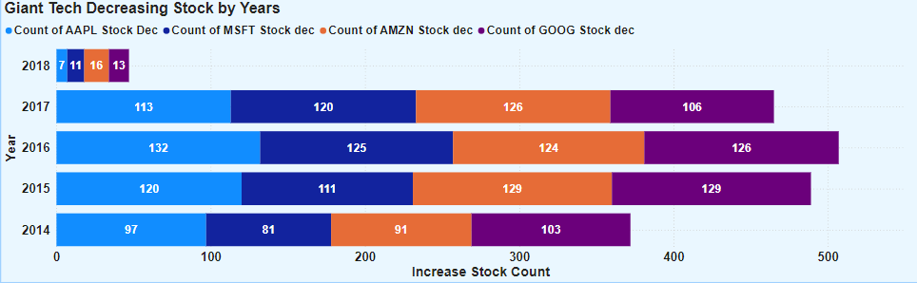
Count of decrease Tech Giants Stock
Tech Giant Stock Decreases:
Apple: In 2014, Apple's stock decreased by 97, with further decreases of 120 in 2015, 132 in 2016, and 113 in 2017. A small decrease of 7 was recorded in 2018. Apple has the highest total stock decrease among the companies analyzed, with an overall decrease of 569. Average Stock Increase: 113.8.
Microsoft: In 2014, Microsoft's stock decreased by 81, followed by decreases of 111 in 2015, 125 in 2016, and 120 in 2017. A small decrease of 11 was recorded in 2018.
Average Stock Increase: 95.7.
Amazon: In 2014, Amazon's stock decreased by 91, with further decreases of 129 in 2015, 124 in 2016, and 126 in 2017. A decrease of 16 was recorded in 2018.
Average Stock Increase: 103.2.
Google: In 2014, Google’s stock decreased by 103, with further decreases of 129 in 2015, 126 in 2016, and 106 in 2017. A small decrease of 13 was recorded in 2018.
Average Stock Increase: 113.

Slide 6
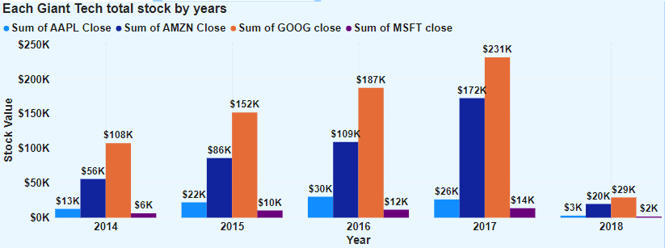
Tech Giants Total Stock
Tech Giant Total stock until 7 of February 2018
Google: Google's total stock value began at $108K in 2014 and increased each year, peaking at $231K in 2017. The sharpest increase occurred between 2016 and 2017, with an additional $44K. In January and February 2018, the total stock value stood at $29K.
Amazon: Amazon’s total stock value started at $56K and increased each year, peaking at $172K in 2017. The sharpest increase occurred between 2016 and 2017, with an additional $63K.
Apple: Apple's total stock value began at $13K in 2014 and increased each year until 2016 with the highest amount of $ 30K in 2016. The sharpest increase occurred between 2014 to 2015, with an additional $ 9K and get decrease in 2017.
Microsoft: Microsoft’s total stock value began at $ 6K in 2014 and increased each year, peaking at $ 14K in 2017. the increase occurred consistently.
Insights:
Google Global Reach: A massive user base worldwide has driven consistent revenue growth and investor confidence.
Amazon E-commerce Leadership: Amazon's dominance in the e-commerce sector has been a major growth driver.

Slide 7
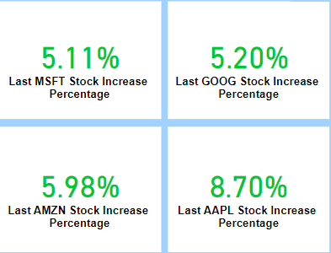


Tech Giants' Stock Increase Percentages
The increase percentages of the Tech Giants’ stock:
Microsoft: 5.11%
Google: 5.20%
Amazon: 5.98%
Apple: 8.70
Highest company stock increase percentages over the years: Apple.
Lowest company stock increase percentages over the years: Microsoft.

Slide 8
THANK YOU
Git URL
GitHub URL Project
KPI Dashboard GitHub URL

